Slide 1
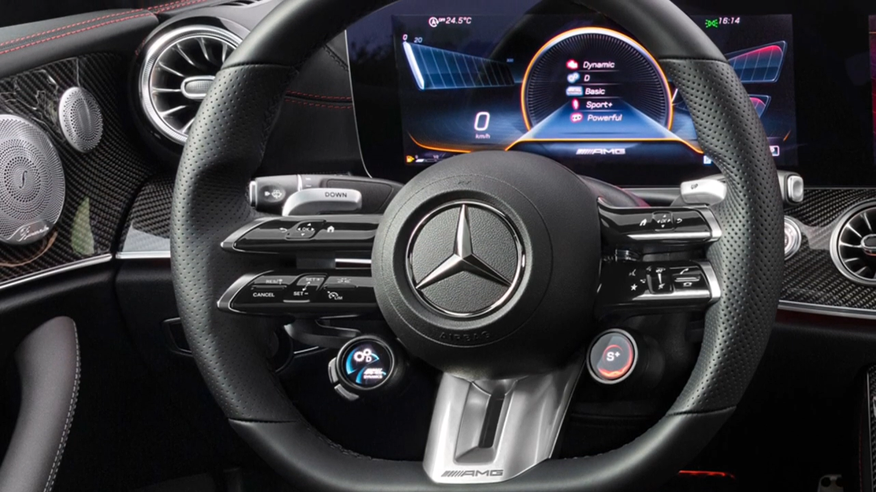
Essentials in Product Design for Higher Quality and Reliability
Natarajan R
EGS India
An ISO 9001:2015 Company

Slide 2







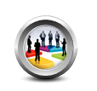







Timeline
EGS India
Opened Operations in Chennai India
EGS India
Expansion of India Operations as Independent Entity
Live!QC Tools
Launch of indigenous Quality Control Software for Manufacturing Industries
EGS Inc. USA
Started Operations in Greenfield, MI
ACADEMIX
Training Division Launched in Chennai, India
EGS India Trichy
Started Operations
1981
1989
1993
1996
1997
1999
2003
2007
2009
2011
2023
2024
SRAC USA
Representation for Cosmos FEA Software in India
Live!PLM
Launch of indigenous PLM Software for Engineering Industries
Adept Engineering
Acquisition of CAE Services Company
EGS India HQ
Shifted to Own Building in Chennai
DS SolidWorks Corp.
Representation for SolidWorks in India
EGS India Coimbatore
Started Operations
Engineering Services
Projects Undertaken for Customers World-wide

Slide 3
Overview
Branches
Presence
Chennai, Coimbatore & Trichy
Varied Experience across many Vertical Industrial Segments with over 2000 Customers
Employees
Affiliation
140 Member Team is the core Strength of EGS
BIS, SAEINDIA, IMTMA, IPI, MMA, NIQR
EGS India
Engineering Global Solutions
Since 1993 in India
Innovation
32 Years of Product Design & Development Experience with OEMs and Tier I & II Suppliers
Unique designs based on Cost, Time & Quality Paradigm – Indegenous Software for Engineering Industries – PLM, Quality Control, APQP & Document Management

Slide 4



Business Model
Software Solutions
Dassault Systemes for 3D CAD (3DEXPERIENCE SOLIDWORKS), FEA (SIMULIA), PDM
Live!PLM
Live!QC Tools
Engineering Services
Technology Training
Product Design & Development
Design Validation
Dimensional Management
Value Engineering
Computer Aided Engineering
GD&T and Tolerance Stacks
FMEA
DFM & A
CAD/FEA
Tools
Design
Knowledge

Slide 5
01 Voice of Customer → Voice of Engineering
Customer says
  ‘High Accuracy’ - Define Accuracy
  ‘Should work in Hot and Cold conditions’ – Temperature Range
  ‘Should be efficient’ – Define Efficiency and its Value Range
  ‘Should be noiseless’ – Define Operating Decibel range
  ‘Should be trouble-free’ – Define Warranty
  ‘Should be cheap’ – Define Price/Cost Range
?

Slide 6
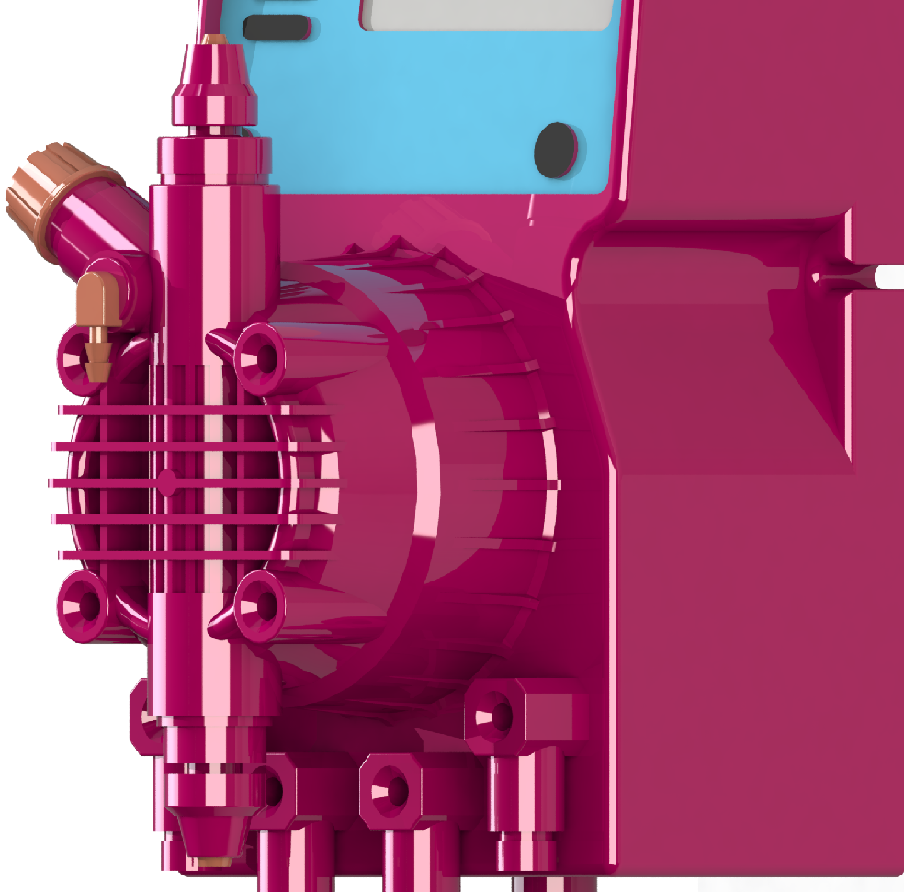
Dosing Pump
Metered dispensation of medicine
Non-reactive material towards chemical agents
No ageing related material degradation for three-year period
Volumetric accuracy to be ±0.5ml in 5ml to 100ml range
Dispensation at 5ml to 100ml in 5-30secs
Pressure 0-2bar
Data acquisition output 0–5V/4–20mA analogue
Air in-line leak detection
Not Autoclavable
Liquid operating temperature 0°C – 40°C
Maintenance free operation for 1-Year with an 8-hour shift
IEC 60601-1, IEC 60601-1-2, ISO 10993, FDA / CE USP Class VI

Slide 7
House of Quality
Customer Requirement | Importance (1 Low – 5 High) | Dosing Accuracy (%) | Viscosity Range Handled – (cP) | Temperature Range Handled (Deg. C) | Wet material compatibility | Cleaning Cycle Time (Min) | Maintenance Interval (Hrs) | Footprint (mmxmm) | Us | Competitor A | Competitor B
Accurate Dosing across Conditions | 5 | ⏺ | ⏺ | ⃘ |  |  |  |  | 4 | 3 | 4
Consistent across Fluid Viscosities | 5 | ⏺ | ⏺ | ∆ |  |  |  |  | 3 | 2 | 4
No leaks/ Seal Integrity | 4 |  | ∆ | ⃘ | ⏺ |  | ⃘ |  | 4 | 4 | 3
Easy to clean between batches | 3 |  |  |  | ⃘ | ⏺ |  | ∆ | 3 | 3 | 2
Low maintenance burden | 4 |  |  |  | ∆ | ⃘ | ⏺ |  | 3 | 2 | 3
Compact Installation Footprint | 2 |  |  |  |  |  |  | ⏺ | 4 | 3 | 2
Compatible with Customer Process Chemicals | 5 |  |  |  | ⏺ | ∆ |  |  | 3 | 2 | 4
Target value |  | ±1% | 5-500cP | 10-40°C | ≥ 6 Chemicals | ≤5 min | ≥2000hrs | ≤ 150X150
⏺ Strong Relationship ⃘ Medium Relationship ∆ Weak Relationship Score: 1 (Poor) to 5 (Excellent)

Slide 8
Material selection Matrix
Selection Criteria from VoC | Weight (1 – 5) | 316L Stainless Steel | PTFE | PVDF | Ceramic (Al₂O₃) | Hastelloy C-276
Chemical Compatibility (Broad Range) | 5 | 3 | 5 | 4 | 5 | 5
Seal Integrity/ No-leak compatibility | 4 | 4 | 3 | 3 | 2 | 4
Ease of Cleaning (Surface finish and CIP) | 3 | 4 | 4 | 4 | 5 | 4
Low maintenance/ Wear Resistance | 4 | 4 | 2 | 3 | 5 | 4
Dimensional Stability across Temperature Range | 3 | 5 | 2 | 3 | 5 | 5
Cost/ Manufactuability | 2 | 4 | 3 | 3 | 2 | 1
Weighted Total |  | 75 | 66 | 66 | 76 | 75
Weighted total = Σ (weight × score) per material, out of a max of 105. Ceramic and Hastelloy lead on chemical durability and wear life; 316L stays competitive on balance and cost; PTFE and PVDF trail mainly on wear resistance and thermal stability despite strong chemical resistance.

Slide 9
01 Voice of Customer → Voice of Engineering Advantages
Objective method for decision making
Translation of Customer requirements without mis-interpretation
Clear specification for Sales & Testing team
Precursor to Cost Analysis
Eliminates/ Reduces Customer dissatisfaction
Opportunity for re-visiting to improve products and develop new technologies

Slide 10
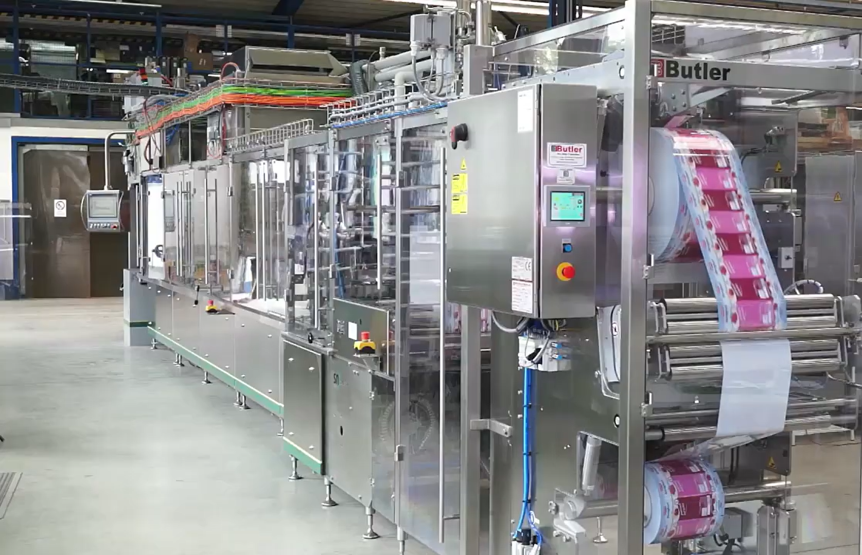
02 Design for Manufacture & Assembly
Minimizing total number of parts
Design Modularity
Standardization of Components
Multi-functional Parts
Multi-use Parts
Ease of Fabrication
Avoiding Separate Fasteners
Minimizing assembly instructions
Maximizing Compliance
Minimizing Handling

Slide 11
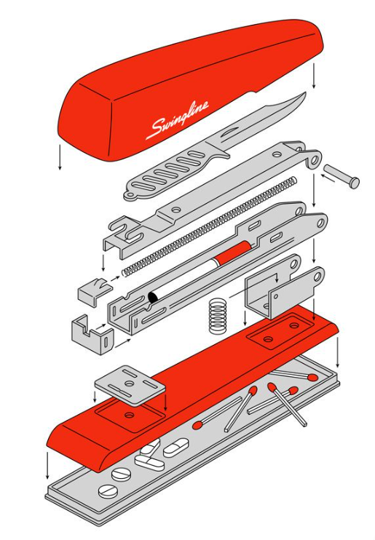
Elimination Rule for a Part
No need for
  Relative Motion
  Subsequent adjustment between parts
  Service or Repairability
  Different materials
Does not add Cost
Does not increase Complexity
Does not complicate handling
Does not require sophisticated assembly/ dis-assembly

Slide 12


Modular Designs
Self-contained
Standard interface to other components
Customization using combination of standard components
Resist Obsolescence
Shortens re-design cycle
New generation designs exploit old generation modules
Cost effective
Ease of Service

Slide 13

Standardized Designs
Reduced Inventory
Enhanced Reliability
Improved repairability
Assured availability
Stable supply base
Cost-effective
Ease of Compliance
Faster Development

Slide 14
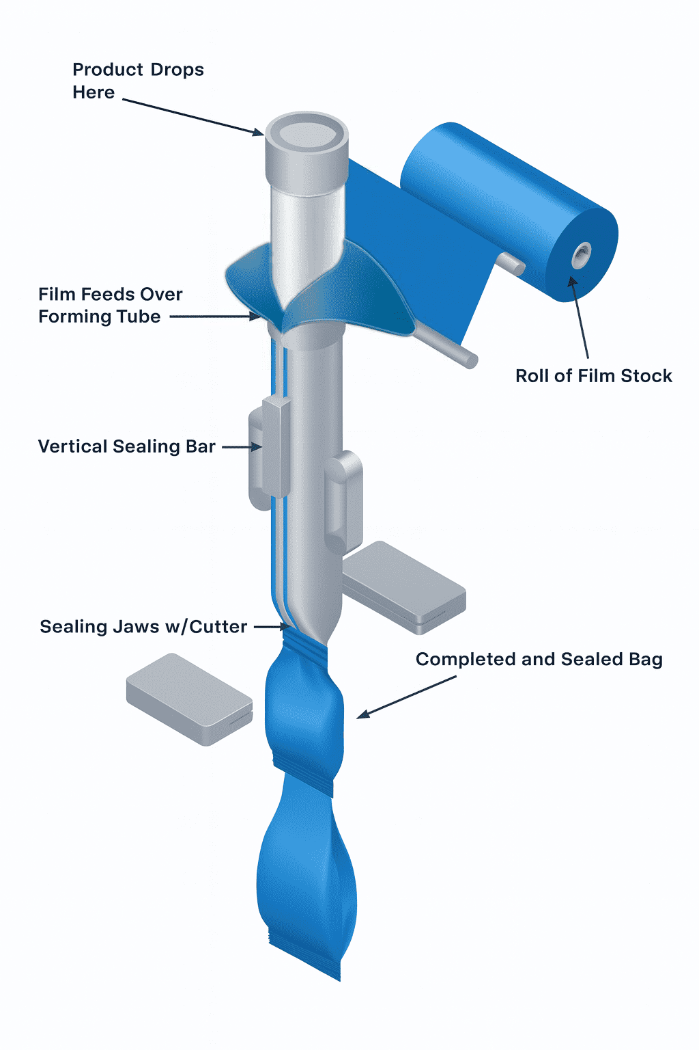
Multi-function Parts - Examples
Sealing and Cutting Jaws: Combine thermal sealing of thermoplastic film with a built-in serrated or hot-wire knife blade to seal and sever the package in a single stroke.
Self-aligning guides: No need for reorientation. Prevents mismatch
Vacuum-Cup Pick-and-Place Nozzles: Create suction to lift and position flat carton blanks or pouches while simultaneously blowing a brief purge of air to clear debris or open the pouch gusset.

Slide 15



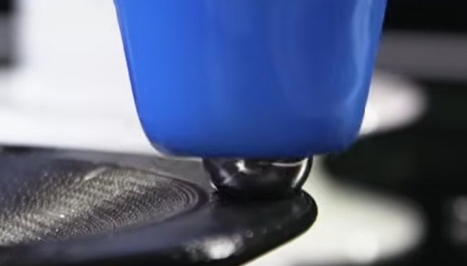
Multi-Use Parts - Examples
No need for tool change over
Adaptive
Configurable
Reduces overall cost of ownership
Reduces assembly complexity

Slide 16
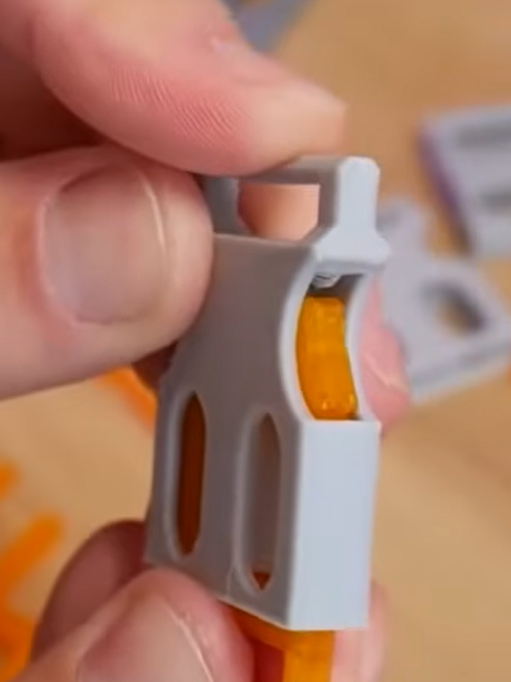
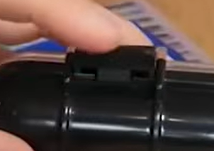

Self-Fastening Designs
Snap-fits
Self-drilling Fasteners
Vacuum-Cup Pick-and-Place Nozzles: Create suction to lift and position flat carton blanks or pouches while simultaneously blowing a brief purge of air to clear debris or open the pouch gusset.

Slide 17
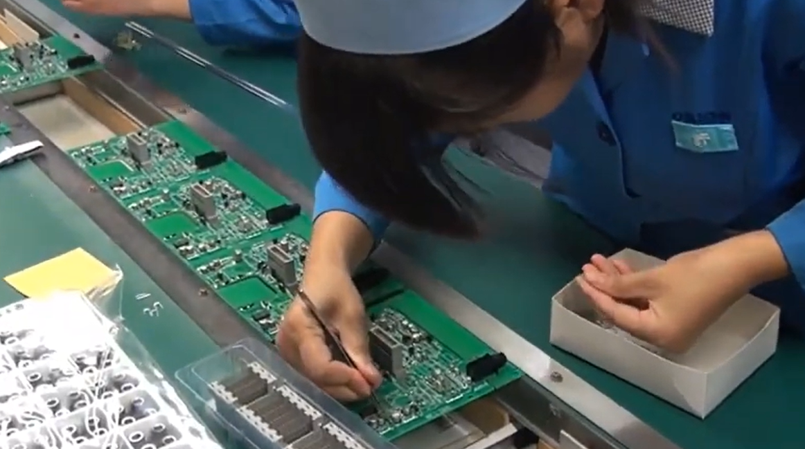
Downstream Benefits
Tool-less operation: removing the need for a torque wrench also removes torque-related defects (over/under-torque) as a failure mode entirely.
Single-operator capability: the original two-technician job becomes a one-person task, freeing a second technician for other line work during changeover.
Reduced training burden: standardized, self-locating interfaces are easier to train new operators on than a bolted, sequence-dependent procedure.

Slide 18
03 Risk Based Thinking in Design
Risk-based thinking means questioning own reference points and assumptions, not just components
The best time to ask "what if this fails?" is at concept review, when the answer is a sketch change, not a tooling change
Scales down to informal design reviews even without a formal DFMEA session — it's a habit, not just a document

Slide 19
Risk based thinking in SPM Design - Examples
Locating off a non-datum surface — As cast surface used for reference for a clamping fixture – not the part’s actual design datum
A single, unmonitored sensor guarding a critical process step (press-fit force check with no redundancy)
No fail-safe position on pneumatic/hydraulic pressure loss — a clamp or lift cylinder that drifts or drops when air pressure dips
Cascading failure from an upstream station jam — no part-present interlock between stations
Structural frame deflection under load — a slow dimensional drift as tooling wears, missed by any single in-process check
Part loading orientation left to operator judgment — a fixture that allows the wrong orientation instead of physically preventing it

Slide 20
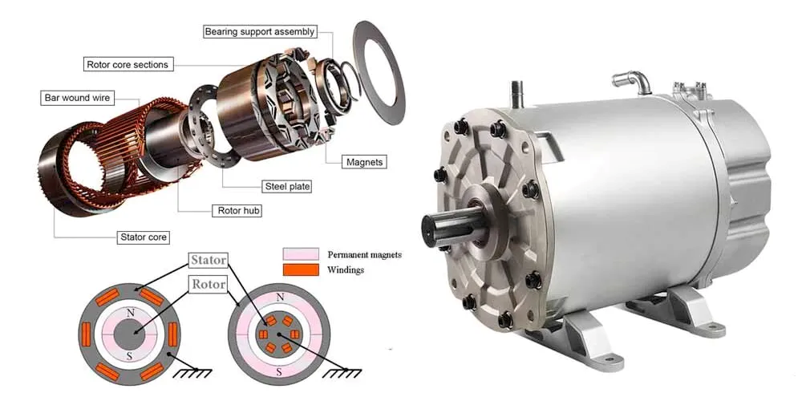
04 Design Margin & Robustness
Design Load > Safe Load > Operating Load
Overload Protection
Load variations are inherent in operation

Slide 21
Why Design Margin needs to be considered?
Nominal-condition compliance is not the same as robustness —“What's the margin?" not just “Does it meet spec?"
Design margin should be sized against real-world variation and transients, not just datasheet steady-state values.
Robustness failures are often invisible until they've already caused cumulative damage — by the time symptoms appear, the root cause is history.

Slide 22
Permanent Magnet Motor Example
Failure mode | Baseline design assumption | Real-world condition that can exceed it | Consequence | Sev (1-5) | Likely (1-5) | Risk | Design action to build margin
Magnet demagnetization | Sized to nameplate rated load only | Transient overload (jam, momentary spike) plus elevated ambient temperature | Permanent, invisible loss of magnet strength; degraded torque with no external sign of damage | 5 | 3 | High | Select magnet grade with demagnetization headroom beyond worst-case transient; validate at max ambient + peak overload together, not separately
Winding insulation breakdown | Insulation class selected for steady-state rated voltage | Inverter PWM dv/dt voltage spikes and reflected-wave transients at motor terminals | Partial discharge and accelerated insulation aging, eventual turn-to-turn short | 5 | 3 | High | Rate insulation system against actual inverter dv/dt and cable length, not just RMS voltage; consider dv/dt filter if drive/cable combination is severe
Bearing electrical fluting | Bearing life calculated from mechanical load spectrum only | Shaft-induced currents from inverter common-mode voltage, uncontrolled by baseline design | Fluting/pitting on bearing races, premature bearing failure well short of calculated L10 life | 4 | 3 | Medium | Add shaft grounding ring or insulated bearing on non-drive end; validate bearing life against electrical, not just mechanical, load

Slide 23
Permanent Magnet Motor Example
Failure mode | Baseline design assumption | Real-world condition that can exceed it | Consequence | Sev (1-5) | Likely (1-5) | Risk | Design action to build margin
Thermal overload / winding overheat | Cooling sized for standard ambient and unobstructed airflow | Elevated enclosure ambient, reduced airflow from dust/fouling, or derated altitude | Accelerated insulation aging, nuisance trips, or thermal-driven demagnetization compounding the first failure mode | 4 | 3 | Medium | Build thermal derating curves against real installation ambient/airflow, not datasheet ambient; specify filter/cleaning interval for the actual environment
Mechanical resonance / vibration fatigue | Natural frequency checked at rated speed only | Operation across a variable-speed range that sweeps through a structural or rotor resonance | Fatigue cracking of mounting/shaft over time, bearing wear acceleration | 3 | 2 | Low | Map resonance frequencies across the full operating speed range, not just rated point; program drive to skip through critical speed bands rather than dwell
Airgap / cogging deviation | Rotor-stator airgap set to nominal tolerance | Manufacturing tolerance stack-up (bearing fit, housing bore, rotor runout) pushing airgap to one tolerance extreme | Increased cogging torque, vibration, and noise; in the worst case, rotor-stator rub | 3 | 2 | Low | Run a tolerance stack-up analysis on the full airgap chain, not just individual part tolerances; add 100% airgap check at final assembly for high-criticality builds

Slide 24

05 Design Verification & Validation (V&V)
Verification confirms the design is built right
Confirms designed right for usage
Need to include misuse and real-world conditions — not just the clean, intended-use case tested on a lab bench.

Slide 25

HMI Example for Design Verification & Validation
Environmental and physical-use test matrix — gloved touch, sunlight/glare, dust/moisture at IP rating, vibration — as documented pass/fail points, not bench-only assumptions
Usability and legibility under operational stress — tested with real operators during simulated alarm/time-pressure conditions, with a defined time-to-recognize / time-to-acknowledge
Response-time and control-latency verification — end-to-end touch-to-feedback latency measured against a spec, especially for safety-relevant actions, not judged "by feel"
Fail-safe and degraded-mode behavior verification — confirming the HMI defaults to a clearly-indicated safe state on comms loss or freeze, rather than silently showing stale data as if live

Slide 26
06 Cross-Functional Design Reviews
Members from Design, Manufacturing, Supply Chain, Service, Inspection need to review the design for feasibility, vulnerability, weak links and any other show-stoppers before sign-off
This is a Mandatory step in Product Design and Development Process
Sign-off commitment from every team member in the CFD is a must before drawing release

Slide 27
06 CFT Design Review Requirements
Right people, right gate, defined in advance
Design intent and requirements traceability need to be shown
Materials/process compatibility checked against real field conditions
Manufacturing/assembly feasibility confirmed by the builders/assembly line supervisors
Known failure modes and risk items revisited
Service/maintainability perspective represented
Every raised issue gets an owner and a closure date
Non-engineering reviewers have real authority to hold the gate

Slide 28
"A design review with only engineers in the room reviews the design against itself. Cross-functional review is what catches the things engineering was never positioned to see."

Slide 29
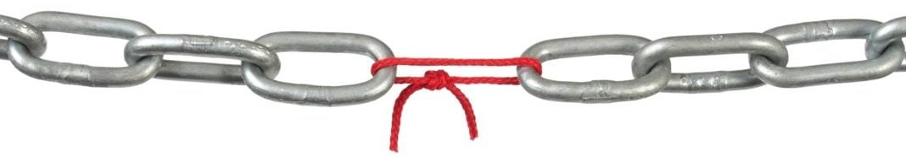
07 Reliability by Design
Engineered in from the start, against the product's actual duty cycle, load spectrum, and operating environment.
Reliability targets should be derived from the actual duty cycle and load spectrum of the specific application, not generic industry defaults.
Component selection (bearings, insulation, magnet grade) should be traceable back to a reliability calculation, not a catalog default.
"Reliability by design" means the reliability number is a design output that the design engineer can defend — not a marketing claim.

Slide 30
Factors affecting Reliability
Loads
Environment
Material
Tolerances
Usage
User behaviour
Combinatorial response
R-Factors

Slide 31
08 Change Management & Design Freeze Discipline
The later a design change happens in the development cycle, the more expensive it is to make correctly and the more likely it is to be made incorrectly
Less time and appetite for full re-verification.
Design freeze discipline exists to protect against exactly this trap.
"Small" late changes are dangerous precisely because they look small. A change that would trigger a full review at concept stage often gets waved through post-freeze as a minor fix — without being re-checked against everything it interacts with.

Slide 32
08 Design Freeze & Change Management
Post-freeze changes need a defined process: impact assessment, re-verification scope, and sign-off — proportional to the change, but never skipped
"Small" is a description of the fix, not a guarantee about its downstream impact — tolerance stack-ups and interactions don’t look at any change as small to ignore
The cost of change increases the later it happens; the discipline around change should increase to match, not decrease under schedule pressure.

Slide 33
Checklist for Change Management
Classify the change first — determines how much rigor everything else needs
Tolerance stack-up impact check — the exact step that when skipped results in a failure downstream
Identify every interfacing system, not just the obvious one
Re-run risk assessment on the changed feature
Define re-verification scope proportional to the change, in writing
Route through a pre-defined approval matrix
Update all documentation and traceability together
Define implementation and rollback plan - effectivity, WIP/field handling, rollback path

Slide 34
Summary – Essentials in Product Design & Development
01 Voice of Customer → Voice of Engineering
02 Design for Manufacture & Assembly
03 Risk Based Thinking in Design
04 Design Margin & Robustness
05 Design Verification & Validation (V&V)
06 Cross-Functional Design Reviews
07 Reliability by Design
08 Design Freeze & Change Management

Slide 35

Q & A
E-mail: info@egs.co.in Mobile: 94454 24704
Since 1993 Engineering Services * SOLIDWORKS Software * Training
Design Automation
Design Verification
Process Automation

Slide 36


